Slide 1
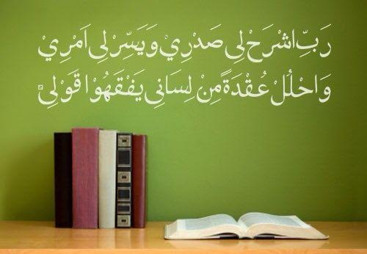
بسم اللہالرحمٰن الرحیم
My Lord, put my heart at peace for me,​ and make my task easy for me and remove the knot from my tongue, so that they may understand my speech.​
​​[20:24-28]​

Slide 2
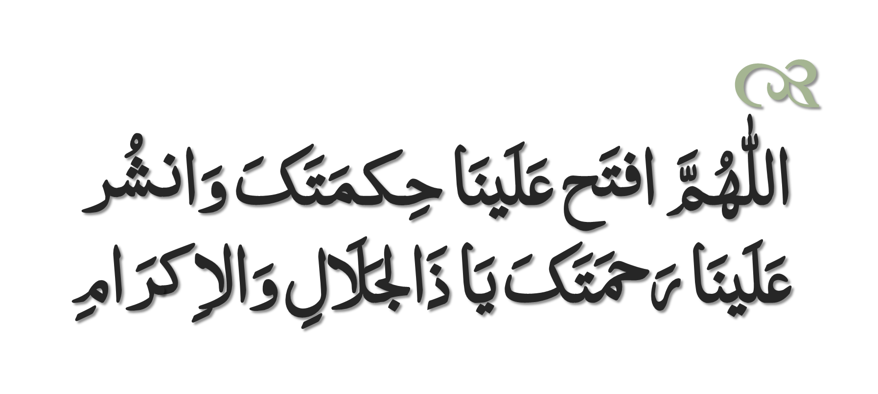
Dua to Recite Before Study

Slide 3
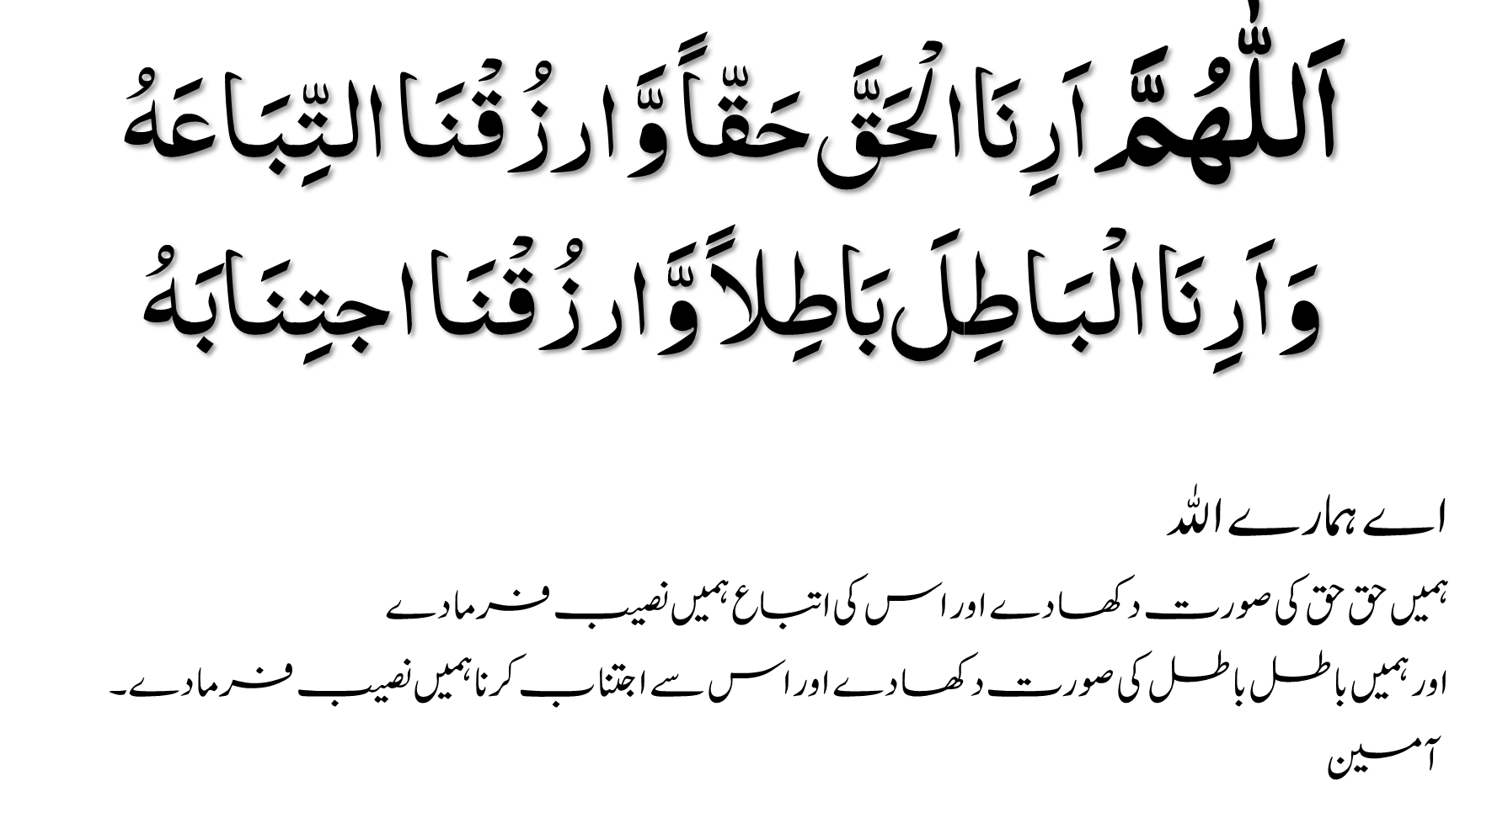

Slide 4

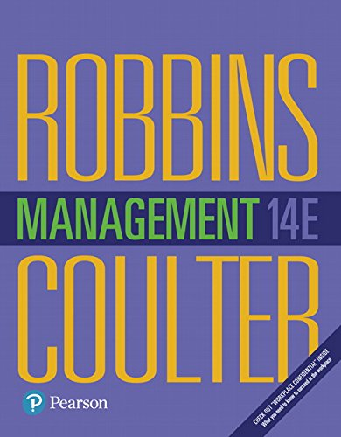

The Book

Slide 5
About the Author:
STEPHEN P. ROBBINS
PhD from the University of Arizona.
worked for the Shell Oil Company and Reynolds Metals Company
Taught at the University of Nebraska at Omaha, Concordia University in Montreal, the University of Baltimore, Southern Illinois University at Edwardsville, and San Diego State University.
He is currently professor emeritus in management at San Diego State.
Dr. Robbins is the world’s best-selling textbook author in the areas of management and organizational behavior. His books have sold more than 76 million copies and have been translated into 20 languages. His books are currently used at more than 1,500 US colleges and universities, as well as hundreds of schools throughout Canada, Latin America, Australia, New Zealand, Asia, Europe, and the Arab world.
Dr. Robbins also participates in masters track competition. Since turning 50 in 1993, he’s won 23 national championships and 14 world titles. He was inducted into the US Masters Track & Field Hall of Fame in 2005.
MARY COULTER received her PhD from the University of Arkansas. She held different jobs including high school teacher, legal assistant, and city government program planner before completing her graduate work. She has taught at Drury University, the University of Arkansas, Trinity University, and Missouri State University. She is currently professor emeritus of management at Missouri State University. In addition to Management, Dr. Coulter has published other books with Pearson including Fundamentals of Management (with Stephen P. Robbins), Strategic Management in Action, and Entrepreneurship in Action.
When she’s not busy writing, Dr. Coulter enjoys puttering around in her flower gardens, trying new recipes, reading all different types of books, and enjoying many different activities with husband Ron, daughters and sons-in-law Sarah and James, and Katie and Matt, and most especially with her two grandkids, Brooklynn and Blake, who are the delights of her life!

Slide 6
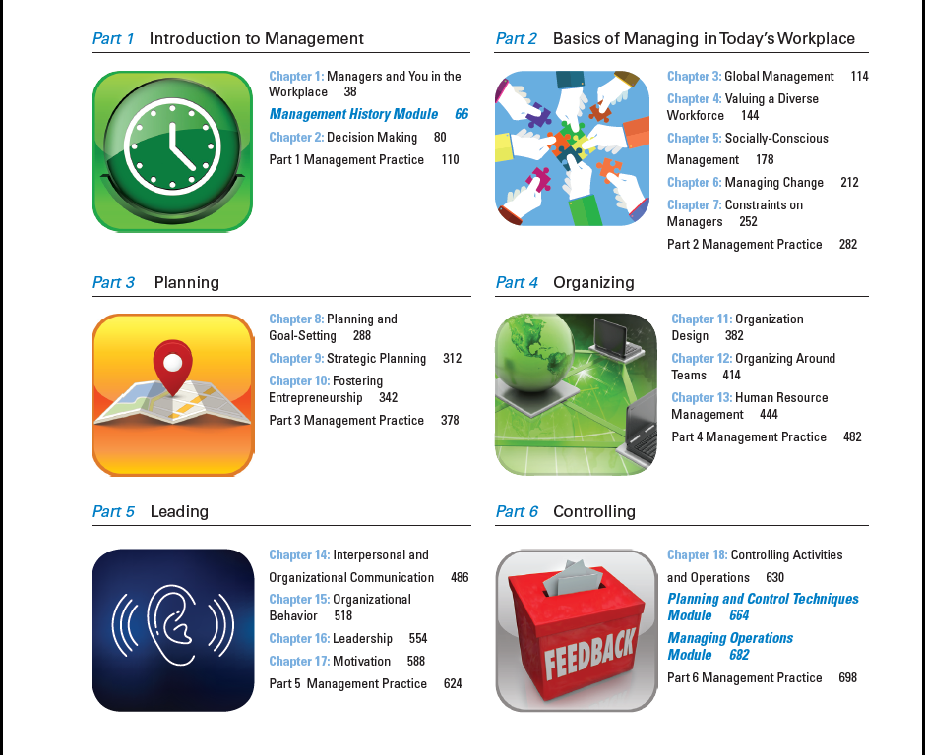

Slide 7

Explain why managers are important to organizations
Tell who managers are and where they work
Describe the functions, roles, and skills of managers
Describe the factors that are reshaping and redefining the manager’s job
Explain the value of studying management

Slide 8
Why are Managers Important?
Organizations need their managerial skills and abilities more than ever in these uncertain, complex, and chaotic times.
Managerial skills and abilities are critical in getting things done.
The quality of the employee/supervisor relationship is the most important variable in productivity and loyalty.

Slide 9

Who Are Managers?
Manager
Someone who coordinates and oversees the work of other people so that organizational goals can be accomplished.

Slide 10
Classifying Managers
First-line Managers - Individuals who manage the work of non-managerial employees.
Middle Managers - Individuals who manage the work of first-line managers.
Top Managers - Individuals who are responsible for making organization-wide decisions and establishing plans and goals that affect the entire organization.

Slide 11
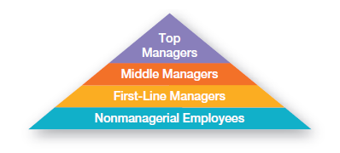
Exhibit 1-1: Levels of Management

Slide 12
Where Do Managers Work?
Organization - A deliberate arrangement of people assembled to accomplish some specific purpose (that individuals independently could not accomplish alone).
Common Characteristics of Organizations
Have a distinct purpose (goal)
Are composed of people
Have a deliberate structure

Slide 13
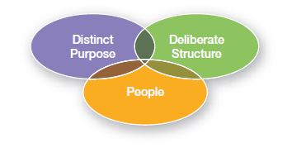
Exhibit 1-2: Characteristics of Organizations

Slide 14
What Do Managers Do?
Management involves coordinating and overseeing the work activities of others so that their activities are completed efficiently and effectively.

Slide 15
Effectiveness and Efficiency
Efficiency
“Doing things right”
Getting the most output for the least inputs
Effectiveness
“Doing the right things”
Attaining organizational goals

Slide 16
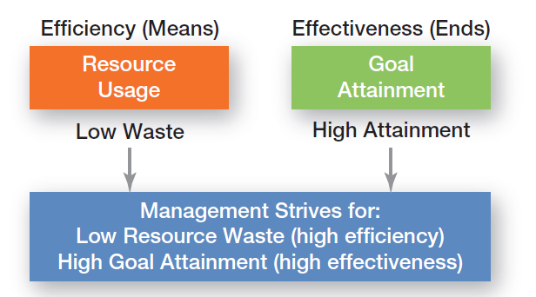
Exhibit 1-3: Efficiency and Effectiveness in Management

Slide 17
Management Functions
Planning - Defining goals, establishing strategies to achieve goals, and developing plans to integrate and coordinate activities.
Organizing - Arranging and structuring work to accomplish organizational goals.
Leading - Working with and through people to accomplish goals.
Controlling - Monitoring, comparing, and correcting work.

Slide 18
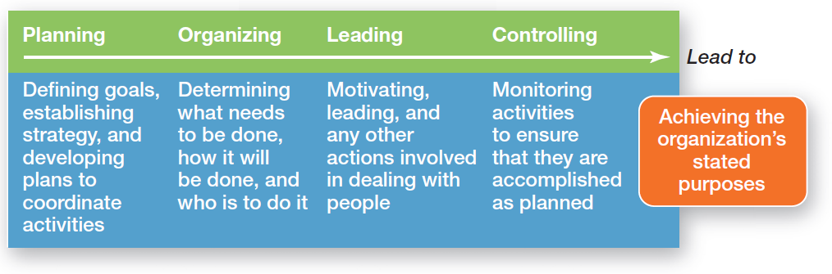
Exhibit 1-4: Four Functions of Management

Slide 19
Management Roles
Roles are specific actions or behaviors expected of a manager.
Mintzberg identified 10 roles grouped around interpersonal relationships, the transfer of information, and decision making.

Slide 20
Management Roles
Interpersonal roles
Figurehead, leader, liaison
Informational roles
Monitor, disseminator, spokesperson
Decisional roles
Entrepreneur, disturbance handler, resource allocator, negotiator

Slide 21
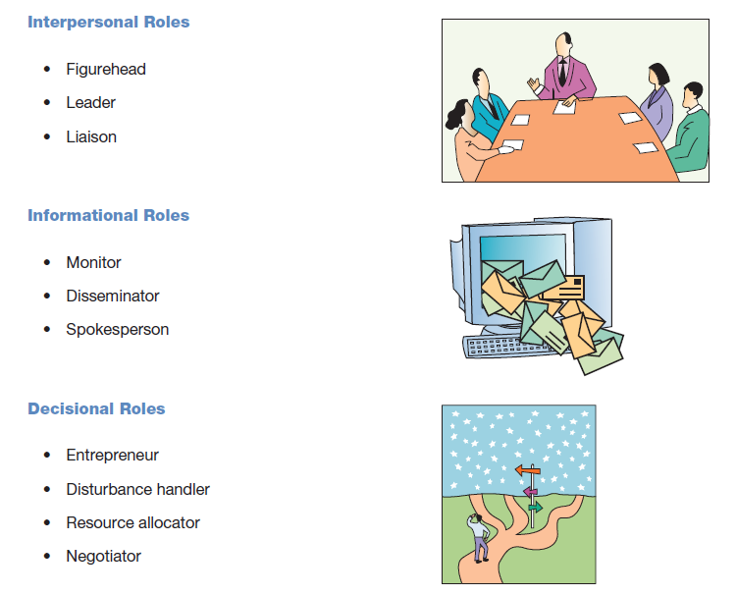
Exhibit 1-5: Mintzberg’s Managerial Roles

Slide 22
Skills Managers Need
Technical skills
Knowledge and proficiency in a specific field
Human skills
The ability to work well with other people
Conceptual skills
The ability to think and conceptualize about abstract and complex situations concerning the organization

Slide 23
Exhibit 1-6: Skills Needed at Different Managerial Levels

Slide 24
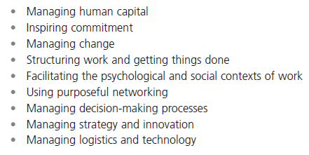
Exhibit 1-7: Important Managerial Skills

Slide 25
The Importance of Customers
Customers: the reason that organizations exist
Managing customer relationships is the responsibility of all managers and employees.
Consistent high quality customer service is essential for survival.

Slide 26
The Importance of Innovation
Innovation
Doing things differently, exploring new territory, and taking risks.
Managers should encourage employees to be aware of and act on opportunities for innovation.

Slide 27

The Importance of Sustainability
Sustainability -
a company’s ability to achieve its business goals and increase long-term shareholder value by integrating economic, environmental, and social opportunities into its business strategies.

Slide 28
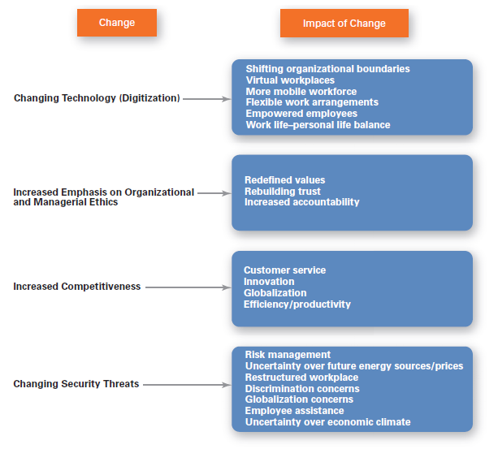
Exhibit 1-8: Changes Facing Managers

Slide 29
Why Study Management?
Universality of Management
The reality that management is needed
in all types and sizes of organizations
at all organizational levels
in all organizational areas
in all organizations, regardless of location

Slide 30
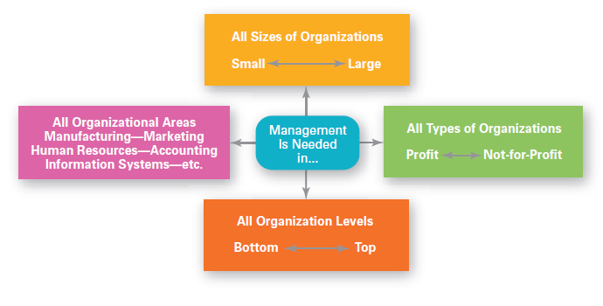
Exhibit 1-9: Universal Need for Management

Slide 31
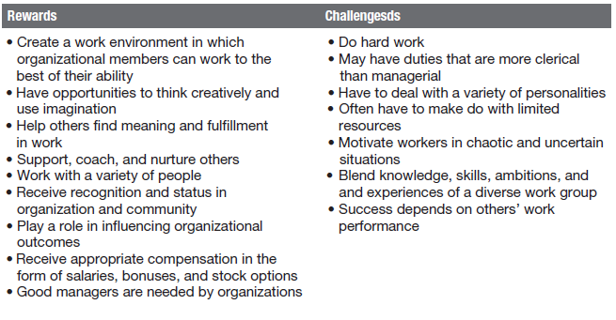
Exhibit 1-10: Rewards and Challenges of Being a Manager

Slide 32
Terms to Know
manager
first-line managers
middle managers
top managers
management
efficiency
effectiveness
planning
organizing
leading
controlling
management roles
interpersonal roles
informational roles
decisional roles
technical skills
human skills
conceptual skills
organization
universality of management

Slide 33
کفارہ مجلس کی دعا
سُبْحَانَكَ اللّٰهُمَّ وَبِحَمْدِكَ ، أَشْهَدُ أَنْ لا إِلٰهَ إِلا أَنْتَ ، أَسْتَغْفِرُكَ وَأَتُوبُ إِلَيْكَ
سیدنا نبی کریم محمدصلی اللہ علیہ وسلم نے فرمایا کہ اگر کوئی آدمی مجلس میں خیر و بھلائی والی بات کرے تو یہ کلمات اس کے لیے روز قیامت تک مہر ثابت ہوں گے لیکن اگر کوئی اور کلام کرے تو یہ کفارہ بن جائیں گے۔

Slide 34


جزاکم اللہ خیراً
JAZAAKUMULLAHU KHAIRAN!

